Slide 1
Chapter 4: Patterns and Styles in
Software Architecture
Session III: Interactive and Hierarchical Systems

Slide 2
Session’s Agenda
Distributed Systems (cont)
  Overview
  Patterns
    Broker
Interactive Systems
  Overview
  Patterns
    Model-View-Controller
Hierarchical Systems
  Main program and Subroutine
  Layered

Slide 3
Distributed Systems
As refresher, distributed systems are decomposed into multiple processes that (typically) collaborate through the network.
  These systems are ubiquitous in today’s modern systems thanks to wireless, mobile, and internet technology.
  These types of distributed systems are easy to spot, since their deployment architecture entails multiple physical nodes.
  However, with the advent of multi-core processors, distributed architectures are also relevant to software that executes on a single node with multiprocessor capability.
Some examples of distributed systems include:
  Internet systems, web services, file- or music-sharing systems, high-performance systems, etc.
Common architectural patterns for distributed systems include:
  Client-Server Pattern (we discussed this one in last session)
  Broker Pattern

Slide 4
Broker Architectural Pattern
The Broker architectural pattern provides mechanisms for achieving better flexibility between clients and servers in a distributed environment.
  In a typical client-server system, clients are tightly coupled with servers.
  This leads to complexity for systems that need to provide services from multiple servers hosted at different locations.
In some software systems, clients (in a distributed environment) need to be able to access services from multiple servers without known their actual locations or particular details of communication.
  When these concerns are separated, it leads to systems that are flexible and interoperable.
The broker pattern decreases coupling between client and servers by mediating between them so that one client can transparently access the services of multiple servers

Slide 5
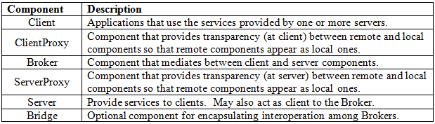
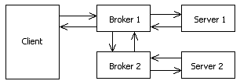
Broker Architectural Pattern
The Broker architectural pattern includes the following components:
An box-and-line example of the broker architecture is presented below.
Broker can communicate with other Brokers that provide access to services from other servers
Client relies on the Broker component to access the services from the server

Slide 6
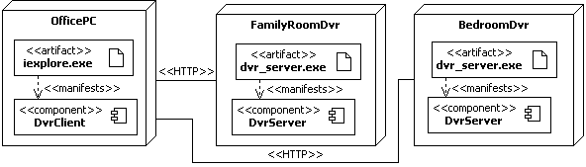
Broker Architectural Pattern
Consider the typical DVR system found in many houses today.
  In this example, there are two DVRs
    One in the family room
    The other in a bedroom
  DVR services can be accessed from inside the house, using the home office PC.
    This could be done in many ways, but for simplicity, assume that access is obtained via the browser, using a Java Applet, Microsoft Active X, etc.
    To gain some insight into the physical architecture of the system, take a look at the following deployment diagram.

Slide 7
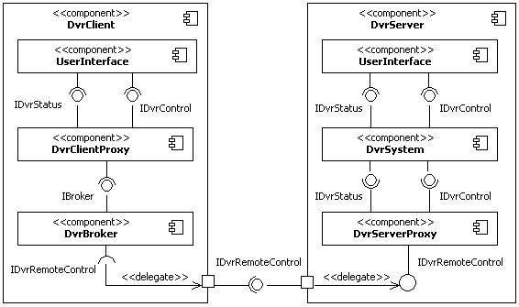
Broker Architectural Pattern
Important:
Remember, this is NOT the physical view of the system!!
The logical architecture can be designed as seen below:
Local component that interfaces with the actual DVR hardware
Provides transparency between remote and local components so that remote component appears as local
Allow remote clients to interface with the DvrSystem as if they were local
Mediates between client and server
The needs of this required interface have been delegated to an unnamed port
The remote control interface
DvrBroker requires IDvrRemoteControl to enable recordings, access list of recorded shows, or get some other information
Delegate the responsibility of providing this interface to the DvrServerProxy component

Slide 8
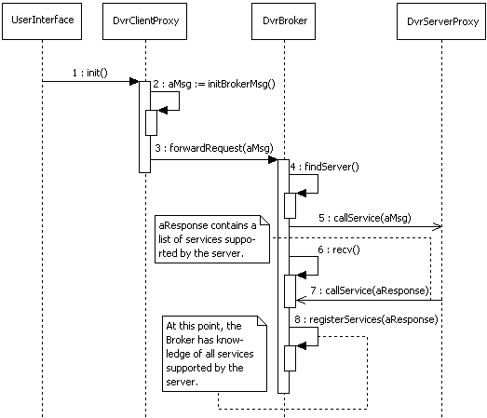
Broker Architectural Pattern
Important:
Remember, this is NOT the physical view of the system!!
Initializing the Broker System

Slide 9
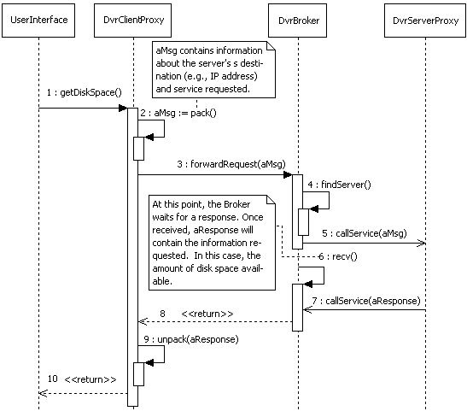
Broker Architectural Pattern
Important:
Remember, this is NOT the physical view of the system!!
Requesting for available disk space
An async message is sent out to the server
An async message is received with the response

Slide 10
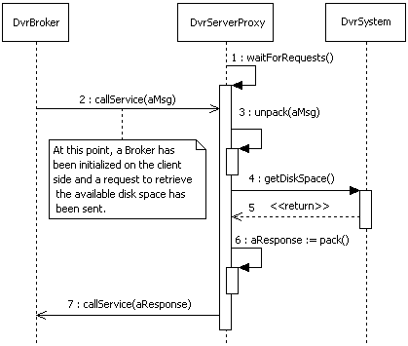
Broker Architectural Pattern
Meanwhile, on the server side…
Retrieve the message id to determine that it is a get free space command
Requests the free space data from the actual DVR system
Package the response in whatever format the system requires for transmission over the network
Send the response to the broker

Slide 11
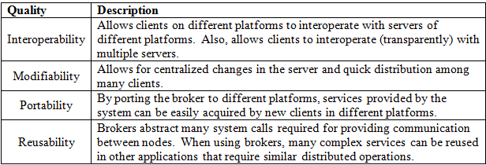
Broker Architectural Pattern
Quality properties of the Broker architectural pattern include the ones specified below.

Slide 12
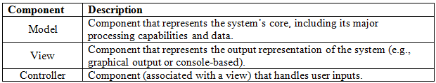
Interactive Systems
Interactive systems support user interactions, typically through user interfaces.
  When designing these systems, two main quality attributes are of interest:
    Usability
    Modifiability
The mainstream architectural pattern employed in most interactive systems is the Model-View-Controller (MVC).
The MVC pattern is used in interactive applications that require flexible incorporation of human-computer interfaces. With the MVC, systems are decomposed into three main types of components:

Slide 13



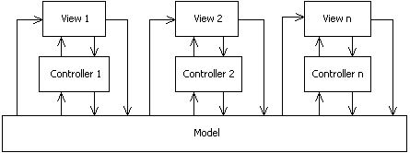
Model-View-Controller Architectural Pattern
Consider the popular example where data needs to be represented in different formats
Line Chart
Bar Chart
Pie Chart
Table
When data changes, all views are updated to reflect the changes.
Different representation of the same data.
Core Data
Data In
Box-and-line diagram of the MVC architectural pattern
View: Display information to the user. Every View is associated with a Controller.
When Model changes, it updates its Views
Controller: Receives input and translates it to service requests.
Model: Encapsulates core data and functionality

Slide 14

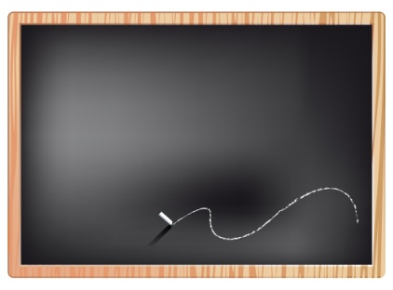
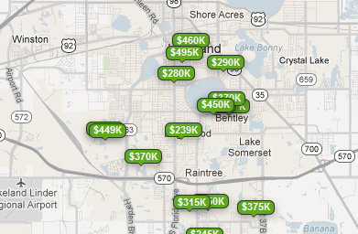


2. Controller uses hand-gesture recognition to translate input to a service request
sendCommand(FIND, SFH, 33803)
Controller
View
Important:
Not a UML diagram!
1. Very large screen, Use hand gestures to interact with control buttons in the systems
3. View is updated to display results of service request.
MVC for the Real Estate System
Model: Encapsulates core data and functionality
View: Display information to the user
A view of the data
Controller: Receives input and translates it to service requests.
Another view of the data
Model
Real estate data resides here. The model encapsulates core data and functionality
View
3. View is updated to display results of service request.
1. Small screen, no room for buttons, therefore, use speech to interact with system
“Find single family home in Lakeland, FL”
sendCommand(FIND, SFH, 33803)
Controller
2. Controller uses speech recognition to translate input to a service request

Slide 15
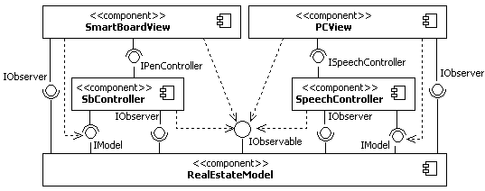
Model-View-Controller Architectural Pattern

Slide 16
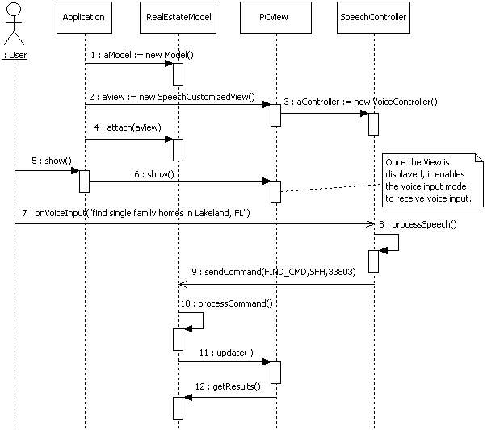
Model-View-Controller Architectural Pattern

Slide 17
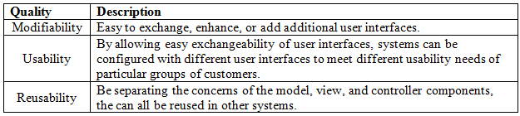
Model-View-Controller Architectural Pattern
Quality properties of the MVC architectural pattern include the ones specified below.
There are many variations of the MVC architectural pattern.
  One popular variation includes the fusion of views and controller components, as made famous in the 1990s by Microsoft’s Document-View architecture
  Other more extensive variations include the process-abstraction-controller pattern.
MVC has been successfully adapted as an architecture for the World Wide Web, e.g., see:
  JavaScriptMVC
  Backbone

Slide 18

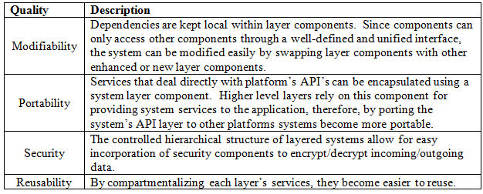
Hierarchical Systems
Hierarchical systems can be decomposed and structured in hierarchical fashion. Two common architectural patterns for hierarchical systems are:
  Main program and subroutine
  Layered
Quality properties of the Main Program and Subroutine architectural pattern include:
Quality properties of the Layered architectural pattern include the ones specified below.

Slide 19
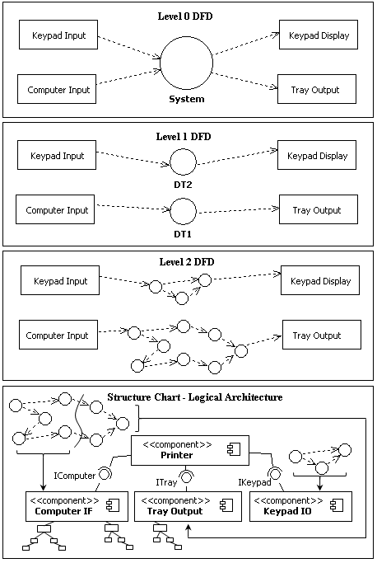
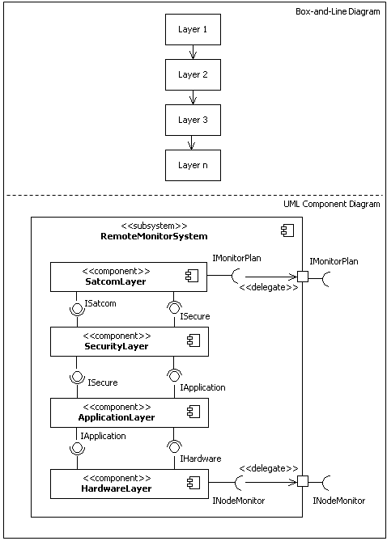
Main Program and Subroutine and Layered Patterns

Slide 20
What’s Next…
In this session, we continued the discussion on distributed systems and presented fundamentals concepts of interactive and hierarchical systems, together with essential architectural patterns for these systems, including:
  Broker
  MVC
  Layered
  Main Program and Subroutine
This finalizes our coverage of architectural patterns. In the next module, we start the discussion on detailed design, which is the next activity in the design process. Detailed design begins once the architecture of the software is sufficiently complete.

